Slide 1


Slide 2

A framework is…
Your Code
Framework
Library
Notes:
Vue.js is a framework. Concept of framework versus library vs program

Slide 3
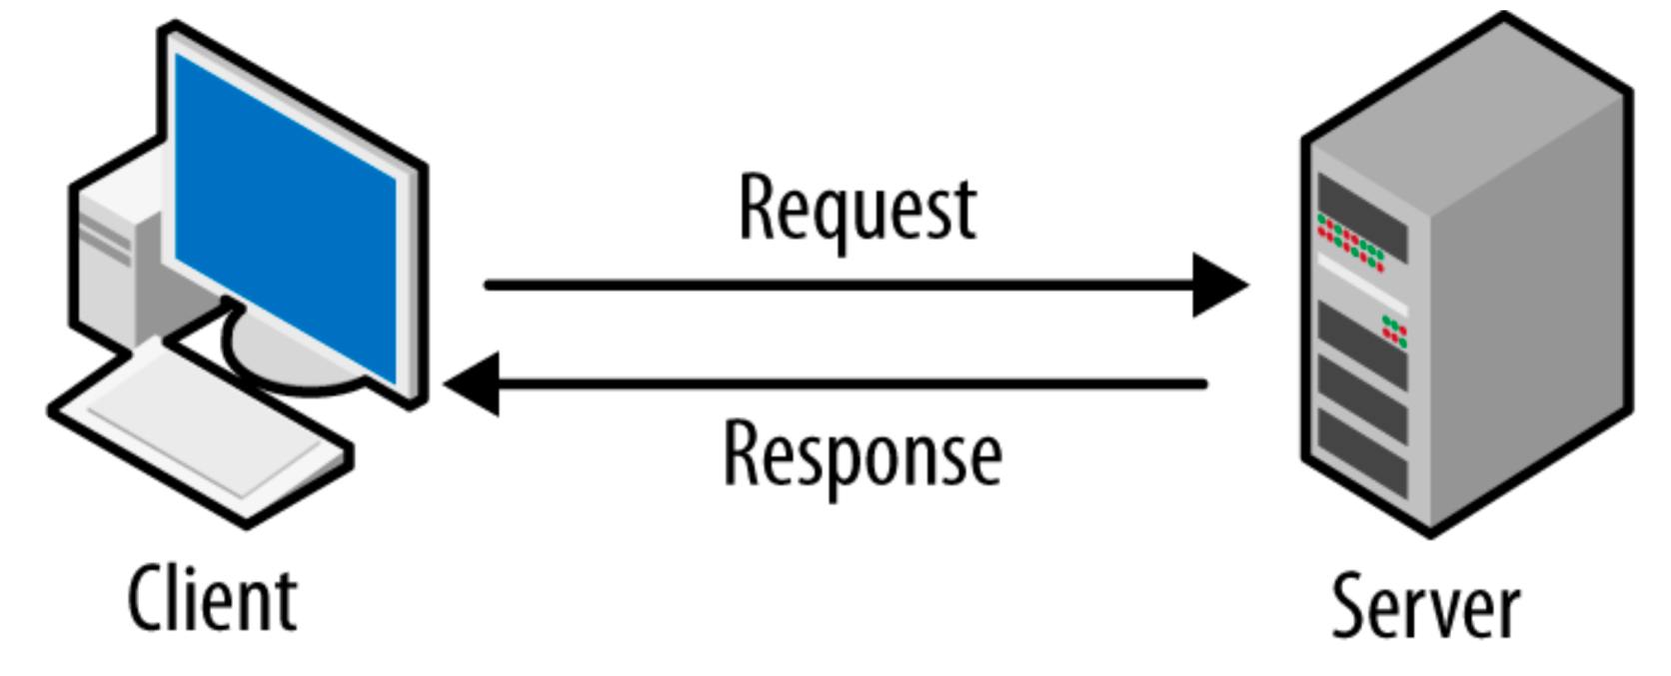

More reactive aplicaciones
Notes:
Classic design (client only shows pages) vs more reactive design client may modify pages e.g. using javascript

Slide 4
But if you increase reactivity…
Notes:
Classic design (client only shows pages) vs more reactive design client may modify pages e.g. using javascript

Slide 5

Notes:
That is why more programers are using javascript framework as react, angular or vue.js

Slide 6
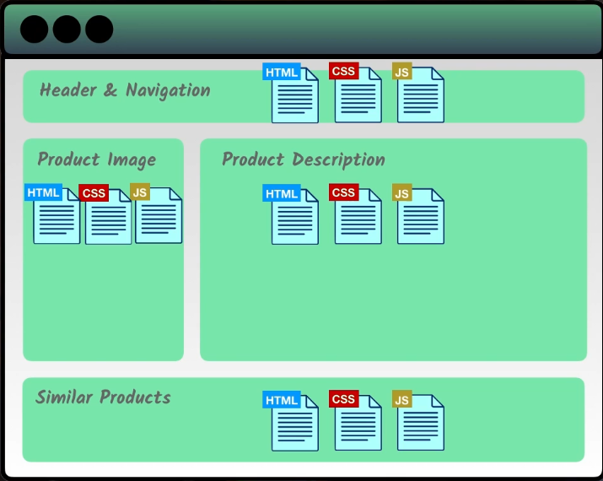
Reusable Components

Slide 7
Vue.js in action…
Open file vue_1.html

